Slide 1
STM32_ADS1299_LayoutGuide
Yumin

Slide 2
PCB TOP
ADS1299-4PAGR
36mm
J401
U201
STM32WB5MMG
U302
DGND
TP223
JTRST
TP218
OSC301
T_SWO
TP221
T_SWDIO
TP219
30mm
KC2016K2.04800C1GE00
T_SWCLK
TP220
U104
U102
TP222
NRST
BQ25185
U101
U103
J102
J101
U301
J301
LSM6DSMTR
VBAT
USB TYPE C

Slide 3
PCB BOTTOM
36mm
30mm

Slide 4
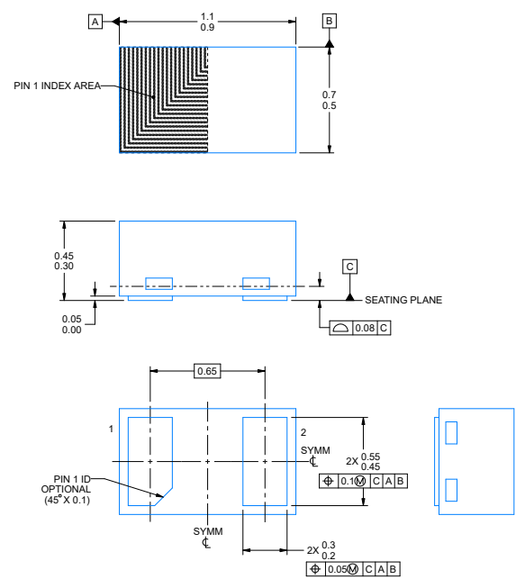
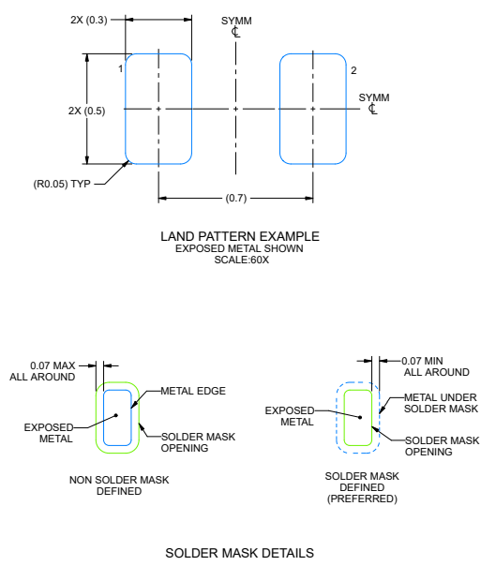
D105,D106,D107
ESD401
NOTES:
1. All linear dimensions are in millimeters. Any dimensions in parenthesis are for reference only. Dimensioning and tolerancing
per ASME Y14.5M
2. This drawing is subject to change without notice.
3. For more information, see Texas Instruments literature number SLUA271 (www.ti.com/lit/slua271).
4. Vias are optional depending on application, refer to device data sheet. If any vias are implemented, refer to their locations shown on this view.
It is recommended that vias under paste be filled, plugged or tented.

Slide 5
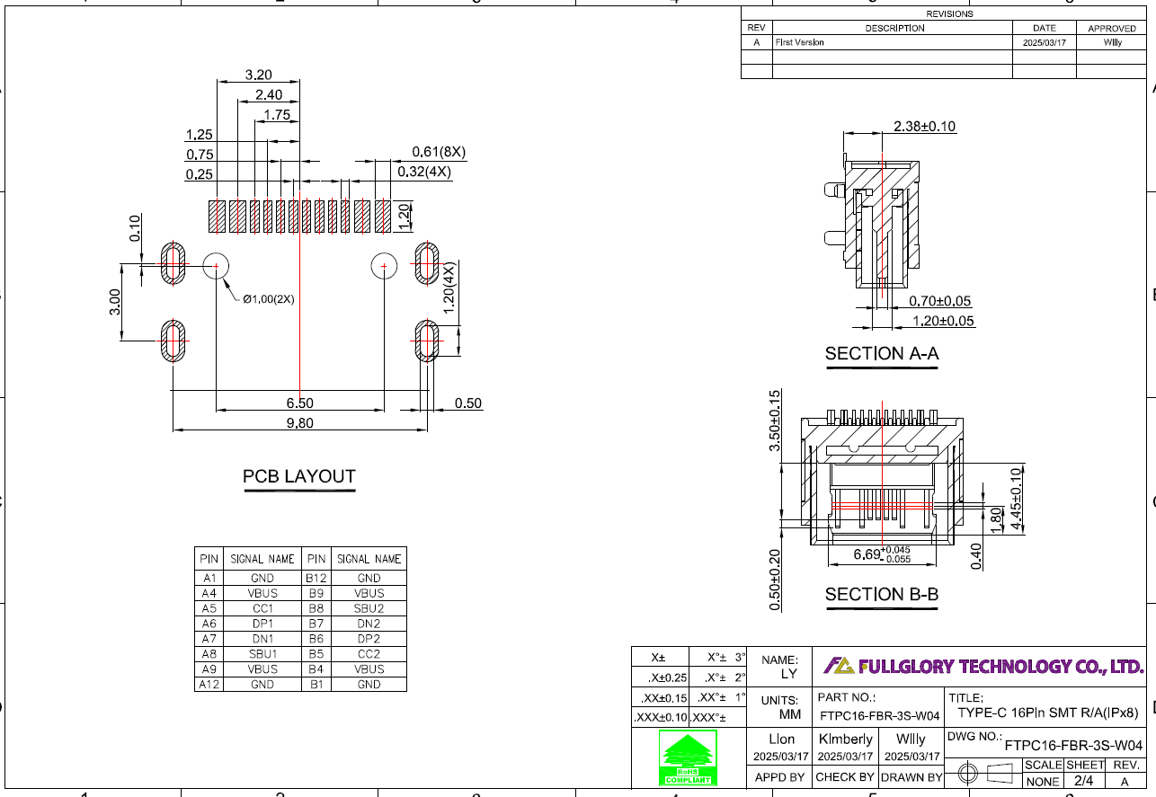
J101
TYPE-CF-W-16-S-R-004

Slide 6
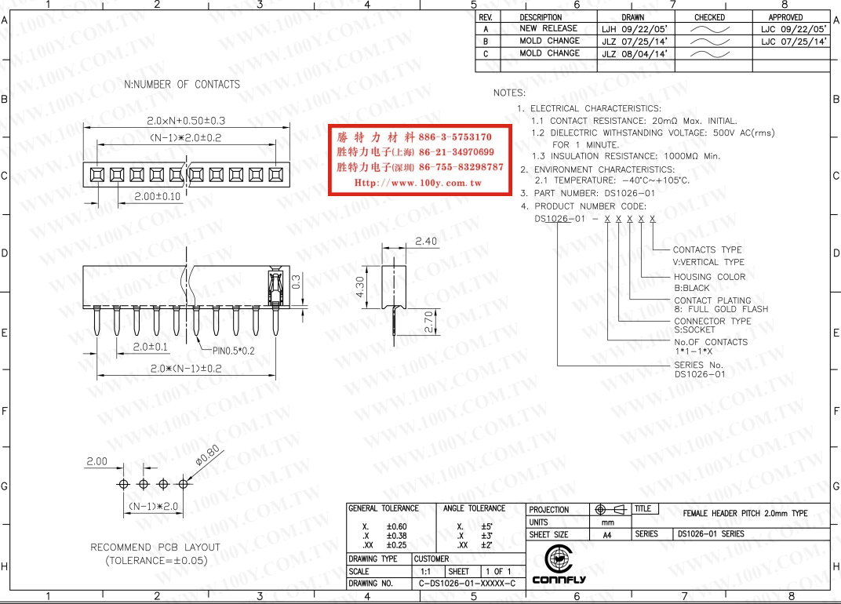
J102
SIP\2P-2MM

Slide 7
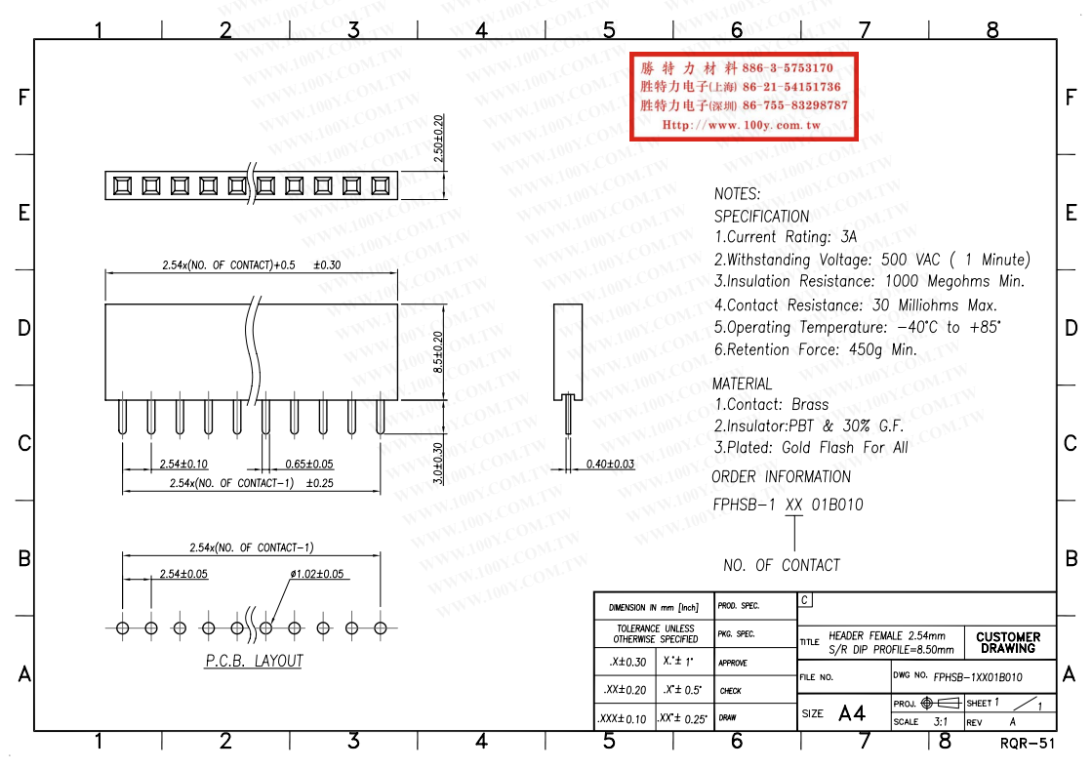
J301
SIP\4P-2.54MM

Slide 8
J401
SIP\9P-2.54MM

Slide 9
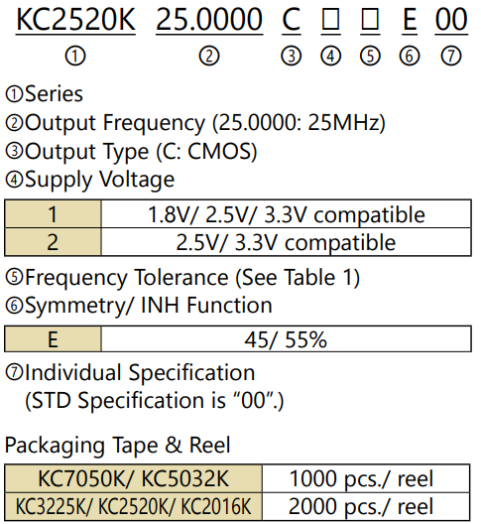
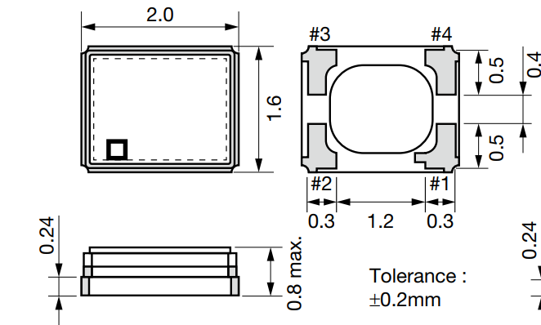
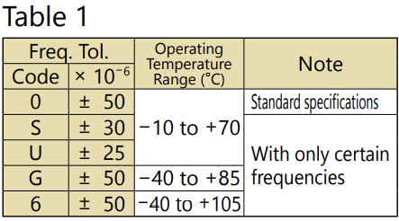
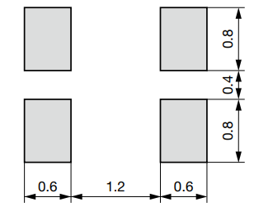
OSC301
KC2016K2.04800C1GE00
Dimensions(Unit: mm)

Slide 10
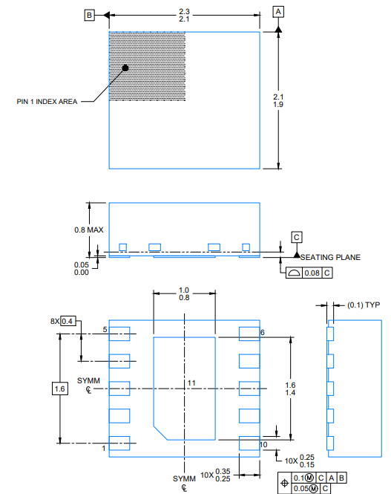
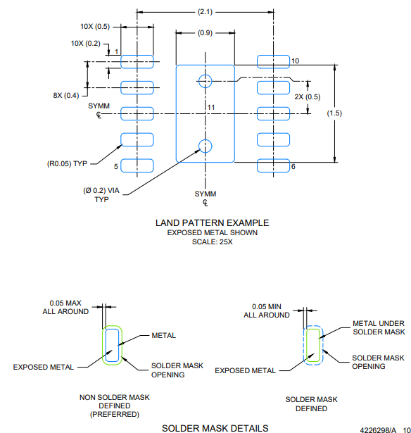
U101
BQ25185
NOTES:
1. All linear dimensions are in millimeters. Any dimensions in parenthesis are for reference only. Dimensioning and tolerancingper ASME Y14.5M.
2. This drawing is subject to change without notice.
3. The package thermal pad must be soldered to the printed circuit board for optimal thermal and mechanical performance.
4. This package is designed to be soldered to a thermal pad on the board. For more information, see Texas Instruments literaturenumber SLUA271 (www.ti.com/lit/slua271).
5. Vias are optional depending on application, refer to device data sheet. If any vias are implemented, refer to their locations shown on this view. It is recommended that vias under paste be filled, plugged or tented.

Slide 11
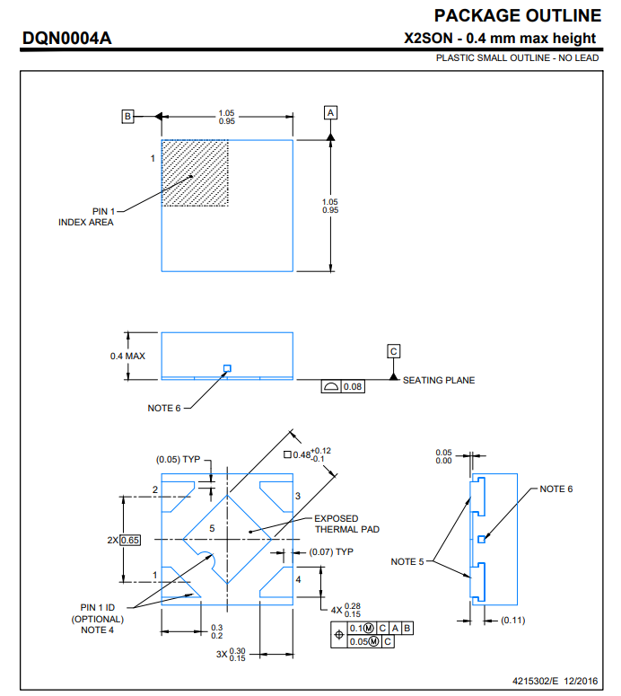
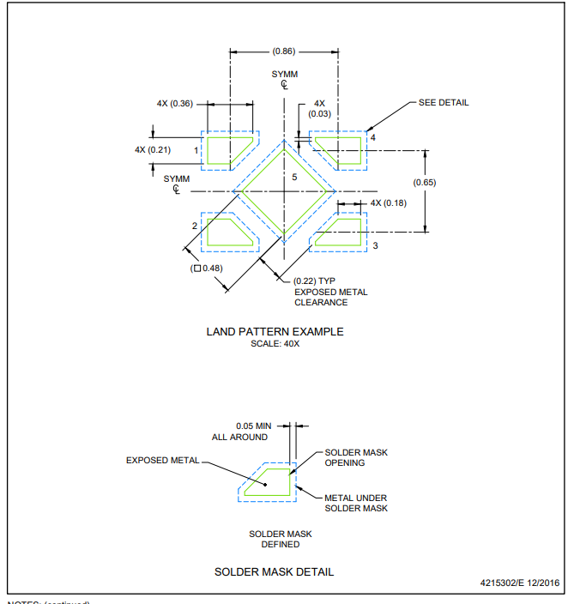
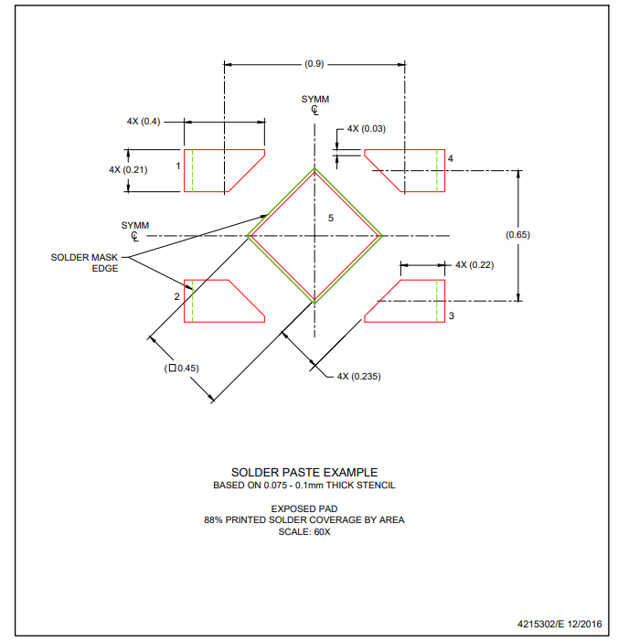
U102、U103、U104
TPS7A2033PDQNR

Slide 12
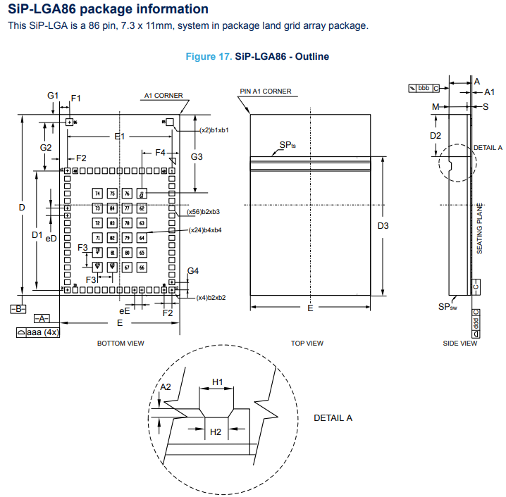
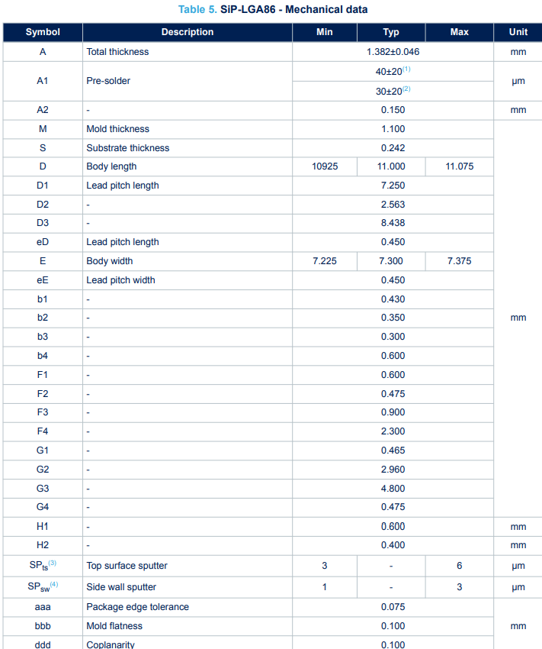
U201
STM32WB5MMGH6

Slide 13
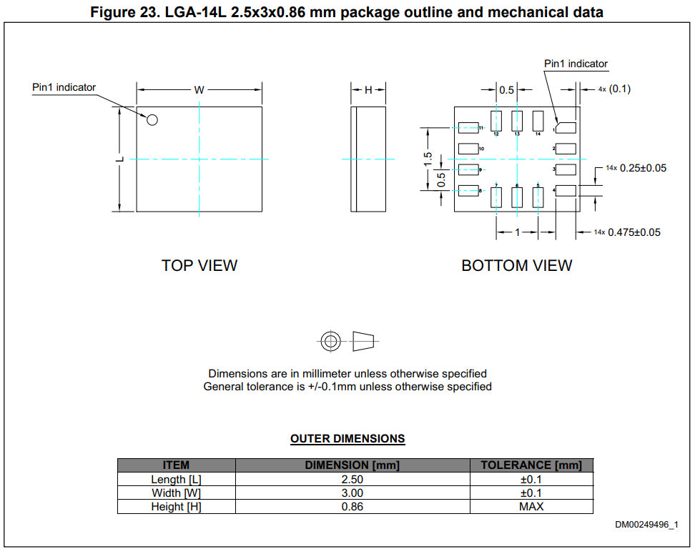
U301
LSM6DSMTR

Slide 14
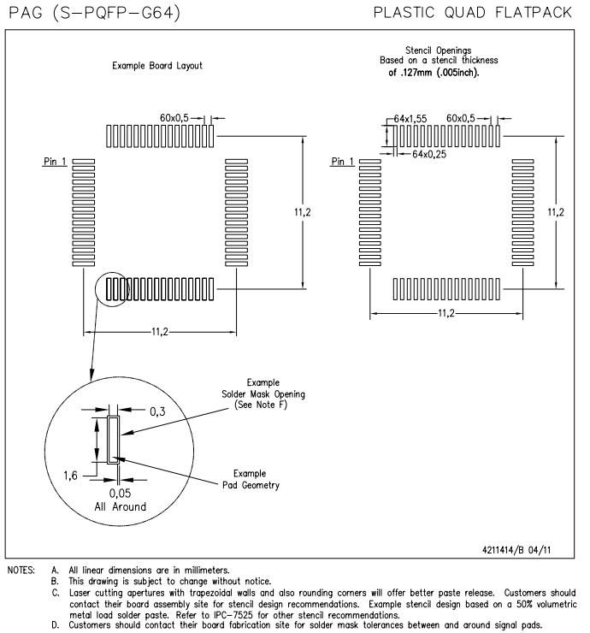
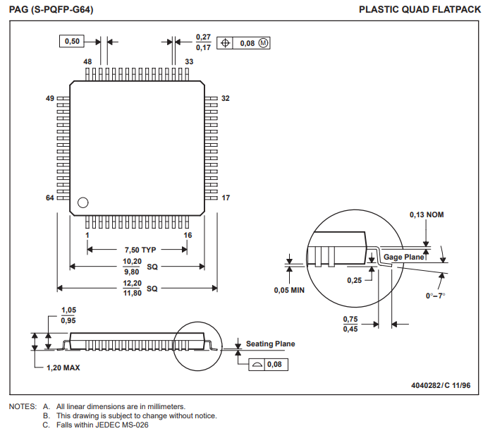
U302
ADS1299-4PAGR

